Slide 1
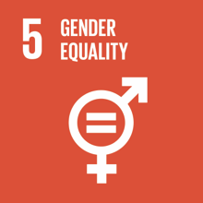
Goal 5: Achieve Gender Equality
and empower all women and girls

Slide 2
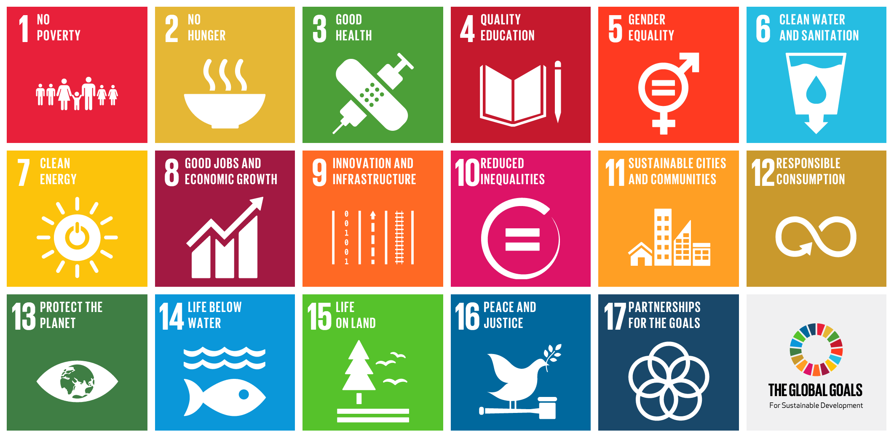
THE SUSTAINABLE DEVELOPMENT GOALS

Slide 3
SDG 5: GENDER EQUALITY
Gender equality is not only a fundamental human right, but a necessary foundation for a peaceful, prosperous and sustainable world.
Providing women and girls with equal access to education, health care, decent work, and representation in political and economic decision-making processes will fuel sustainable economies and benefit societies and humanity at large.
Implementing new legal frameworks regarding female equality in the workplace and the eradication of harmful practices targeted at women is crucial to ending the gender-based discrimination prevalent in many countries around the world.

Slide 4
The main objectives of SDG5 are:
End all forms of discrimination against all women and girls everywhere.
Eliminate all forms of violence against all women and girls in the public and private spheres, including tracking and sexual and other types of exploitation.
Eliminate all harmful practices, such as child, early and forced marriage and female genital mutilation.
Recognise and value unpaid care and domestic work through the provision of public services, infrastructure and social protection policies and the promotion of shared responsibility within the household and the family as nationally appropriate.
Ensure women’s full and effective participation and equal opportunities for leadership at all levels of decision-making in political, economic and public life.

Slide 5
The main objectives of SDG5 are:
Ensure universal access to sexual and reproductive health and reproductive rights as agreed in accordance with the Programme of Action of the International Conference on Population and Development and the Beijing Platform for Action and the outcome documents of their review conferences.
Undertake reforms to give women equal rights to economic resources, as well as access to ownership and control over land and other forms of property, financial services, inheritance and natural resources, in accordance with national laws.
Enhance the use of enabling technology, in particular information and communications technology, to promote the empowerment of women.
Adopt and strengthen sound policies and enforceable legislation for the promotion of gender equality and the empowerment of all women and girls at all levels.
Link - http://www.un.org/sustainabledevelopment/gender-equality/

Slide 6
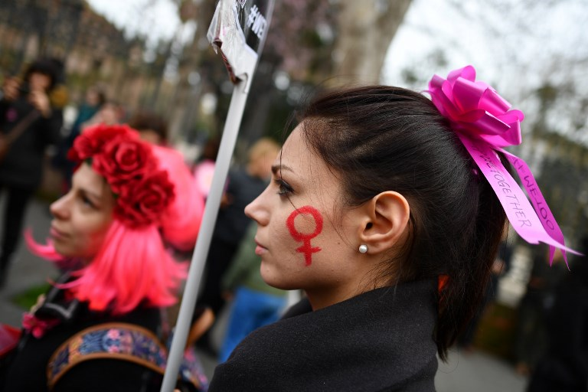
12 Statistics that show the state of Gender Equality in Italy

Slide 7
SOME DATA
ITALY is on the 14° position between the 28 Eu members
Italy's pay gap is a little over 5%
Fewer than half of working-age Italian women are in employment
Around 62% of Italian women's work each day is unpaid compared to 30 percent for Italian men
14% of women are graduated compared to 12% of men
Just 31% of Italy's last parliament was female
Women made up a measly 16% of decision-making bodies in 2017
In 2017, 121 women in Italy were murdered, according to police figures
Police handled 4,261 cases of sexual violence last year, of which 54% took place on the street or in cars
Some 3.5 million women in Italy have been victims of stalking at least once between the ages of 16 and 70
Almost half of Italy's adult women have experienced some form of sexual harassment
Women are more likely to read, go to the theatre, visit a museum or gallery, or create online content, according to Istat. For instance, in 2016, 47% of girls and women over the age of 6 said they had a read a book in the past 12 months; for boys and men, the figure was 34 percent
Women in Italy have an average life expectancy of 84.9 years while men are expected to live to 80.6

Slide 8
Resources
VIDEOS
https://www.youtube.com/watch?v=PtPBgtnD7KU
https://www.youtube.com/watch?v=H2ILmsXt4uQ
PROJECTS
http://www.jcvg.eu/site/it/project
https://wedo.org/what-we-do/our-focus-areas/
TOOLS FOR GENDER EQUALITY
https://www.rri-tools.eu/search-engine#filterOption=33843,40105@order=@page=1
https://toolkit.ineesite.org/pocket_guide_to_gender/implementation_tools
http://www.unescobkk.org/education/gender/resources/other-gender-websites-and-databases/
https://lgbtrc.usc.edu/education/activities/
WEBSITES
https://eige.europa.eu/gender-equality-index/2015/DK - European Institue for Gender Equality
http://fra.europa.eu/en - European Union Agency for Fundamental Rights
http://www.lgbt-ep.eu/ - European Intergroup for LGBT Rights
https://cild.eu/ - Coalizione Italiana Libertà e diritti civili
http://www.unar.it/ - Ufficio Nazionale Antidiscriminazioni Raziali

Slide 9
Resources
http://www.oecd.org/gender/data/?fbclid=IwAR2IxcZ_4zQls6t8Z7d7C9a9R9cZHMPNhAGVhaHUTKZyXyUaW4hh2EaWji0
https://www.internationalwomensday.com/Theme
https://www.un.org/sustainabledevelopment/sustainable-development-goals/

